Slide 1
Real Time Human Fight Scene Detection

Slide 2
Overview
Problem Statement
Data Collection and Preprocessing
Model Selection and development
Training and Testing Result
GUI Development (input from Video File)
GUI Development (input from Camera Stream)

Slide 3
Introduction
I welcome you to today's presentation, where we delve into the innovative realm of real-time violence detection using the MobileNetV2 architecture. In an era marked by an ever-increasing demand for safety and security, the ability to identify potentially dangerous situations swiftly and accurately holds paramount importance. Violence detection, particularly in real-time scenarios, is a complex yet pressing challenge that transcends various domains, including security, law enforcement, and public safety. Our project aims to address this challenge by leveraging the power of deep learning and computer vision techniques.

Slide 4
Introduction(contd.)
Applications:
Security and Surveillance: Enhancing surveillance systems to detect violence in crowded places, public events, and sensitive areas.
Public Safety: Prompt response to violence in public spaces, preventing harm and facilitating law enforcement intervention.
Content Moderation: Swift identification and removal of violent content from online platforms for a safer internet.
Humanitarian Aid: Crucial for ensuring the safety of aid workers and affected populations during disaster relief operations.

Slide 5
Data Collection and Processing
Dataset Title: Violence Recognition from Videos
Citation: M. Soliman, M. Kamal, M. Nashed, Y. Mostafa, B. Chawky, D. Khattab, “Violence Recognition from Videos using Deep Learning Techniques,” Proc. 9th International Conference on Intelligent Computing and Information Systems (ICICIS'19), Cairo, pp. 79-84, 2019.

Slide 6
Data Collection and Processing(contd.)
Content : This Dataset Contains 1000 Violence and 1000 non-violence videos collected from Youtube videos, violence videos in our dataset contain many real street fights situations in several environments and conditions. also non-violence videos from our dataset are collected from many different human actions like sports, eating, walking …etc.

Slide 7
Data Collection and Processing(contd.)
Frame Extraction:
Got the total number of frames in all the videos
Calculated the interval after which frames will be added to the lists.
Set the current frame position of the video, resized the frame to fixed height and width.
Normalized the resized frame, appended the normalized frame into the frames list.

Slide 8
Data Collection and Processing(contd.)
Creating the Data:
By iterating through all the classes got the list of video files present in the specific class name directory.
Extracted the frames of the video file.
Checked if the extracted frames are equal to the SEQUENCE_LENGTH specified. So ignored the vides having frames less than the SEQUENCE_LENGTH then appended the data to their respective lists.
Converted labels into one-hot-encoded vectors.

Slide 9
Model Selection and development
Why MobileNet over YOLO Algorithm?

Slide 10
Model Selection and development(contd)
Real-Time Performance:
MobileNetV2: MobileNetV2 is renowned for its speed and efficiency. It is specifically designed for applications where real-time performance is crucial. Violence recognition in camera streams often requires rapid decision-making, making MobileNetV2 a favorable choice.
YOLO: While YOLO is a powerful object detection algorithm, its real-time performance can be demanding in terms of computational resources. Achieving high FPS (frames per second) may require specialized hardware, making it less practical for resource-constrained environments.

Slide 11
Model Selection and development(contd)
Resource Efficiency:
MobileNetV2: MobileNetV2 is a lightweight neural network architecture that strikes a balance between model complexity and accuracy. It can run on a variety of hardware, including mobile devices and embedded systems, making it suitable for scenarios where resource efficiency is essential.
YOLO: YOLO models tend to be more complex and resource-intensive. Deploying YOLO on edge devices or low-power systems might pose challenges in terms of computational requirements.

Slide 12
Model Selection and development(contd)
Ease of Deployment:
MobileNetV2: Due to its lightweight nature, MobileNetV2 can be seamlessly deployed on various platforms, including edge devices, smartphones, and IoT (Internet of Things) devices. Its compatibility with TensorFlow Lite and ONNX Runtime simplifies deployment.
YOLO: Deploying YOLO models can be more complex, requiring specialized optimizations and hardware support for optimal performance. This can be a barrier for practical deployment in some cases.

Slide 13
Model Selection and development(contd)
Customization and Transfer Learning:
MobileNetV2: MobileNetV2 provides the flexibility to fine-tune the model on domain-specific data. Transfer learning with MobileNetV2 allows you to adapt the model for violence recognition by retraining on a smaller dataset.
YOLO: YOLO also supports transfer learning, but its architecture might be overkill for specific tasks like violence recognition. Fine-tuning a YOLO model can be more resource-intensive.

Slide 14
Model Selection and development(contd)
Accuracy vs. Speed Trade-Off:
MobileNetV2: MobileNetV2 offers a reasonable balance between accuracy and speed. While it may not achieve the absolute highest accuracy, it provides a good compromise, making it suitable for real-time violence recognition.
YOLO: YOLO models can achieve high accuracy but may require significant computational resources to maintain real-time performance. The choice depends on the specific requirements of the violence recognition application.

Slide 15
Model Selection and development(contd)
The model's backbone is the MobileNetV2 architecture, pretrained on the ImageNet dataset. MobileNetV2 is chosen for its efficiency and effectiveness in feature extraction from images.
Fine-tuning is applied to the MobileNetV2 model to make the last 40 layers trainable while freezing the earlier layers. This allows the model to adapt to violence recognition-specific features.

Slide 16
Model Selection and development(contd)
To capture temporal dependencies within video sequences, the model incorporates LSTM layers. Bidirectional LSTM (Bi-LSTM) layers are used to analyze sequences both forwards and backwards.
LSTM layers help the model understand the context and temporal dynamics of violence-related actions within the video.
After LSTM processing, a series of fully connected layers are introduced to perform high-level feature aggregation and mapping.

Slide 17
Model Selection and development(contd)
Dropout layers are used to mitigate overfitting and improve generalization.
The final layer consists of a softmax activation function, which produces class probabilities for violence and non-violence classes.
The model is trained to classify video sequences into one of these two categories based on the learned features.

Slide 18
Model Selection and development(contd)
Difference Between Optimized and Unoptimized Models
Unoptimized Model: The unoptimized model starts with a pre-trained MobileNetV2 base model. It uses a TimeDistributed layer to apply MobileNetV2 to each frame in a sequence of frames. It then employs Bidirectional LSTM layers for sequence analysis.
Optimized Model: The optimized model also utilizes MobileNetV2 as its backbone but incorporates more advanced fine-tuning techniques. It employs TimeDistributed layers, Bidirectional LSTMs, and additional dense layers for improved feature extraction and classification.

Slide 19
Model Selection and development(contd)
Difference Between Optimized and Unoptimized Models
Unoptimized Model: The unoptimized model does not explicitly mention fine-tuning of layers. It retains MobileNetV2's pre-trained weights throughout.
Optimized Model: In contrast, the optimized model fine-tunes MobileNetV2 to make only the last 40 layers trainable. This allows for more control over feature extraction while preserving valuable pre-trained knowledge.

Slide 20
Model Selection and development(contd)
Difference Between Optimized and Unoptimized Models
Unoptimized Model: The unoptimized model consists of TimeDistributed layers, Bidirectional LSTMs, and dropout layers. It may have a simpler architecture.
Optimized Model: The optimized model incorporates additional dense layers for further feature refinement. It introduces dropout layers to reduce overfitting and improve generalization.

Slide 21
Model Selection and development(contd)
Difference Between Optimized and Unoptimized Models
Unoptimized Model: The unoptimized model's architecture may not provide as much flexibility for feature engineering and fine-tuning.
Optimized Model: The optimized model offers more control over the network's architecture and allows for fine-tuning at specific layers. This flexibility can lead to better model performance.

Slide 22
Model Selection and development(contd)
Pruning and Quantization of Optimized Model
How We Applied Pruning: In our model, we applied pruning specifically to the Long Short-Term Memory (LSTM) layers, which are crucial for sequential data processing. We used the TensorFlow Model Optimization library to "prune low magnitude" connections within these layers.
Why Prune LSTM? LSTM layers are known for their heavy computational requirements. Pruning them enables us to remove less significant connections, resulting in a more efficient model while retaining essential information.

Slide 23
Model Selection and development(contd)
Pruning and Quantization of Optimized Model
How We Applied Quantization: Similar to pruning, we applied quantization to the LSTM layers within our model. Using the TensorFlow Model Optimization library, we "quantize-annotated" these layers, which essentially reduces the precision of numerical values while maintaining acceptable performance.
Quantization Benefits: Quantization significantly reduces model size and makes it more hardware-friendly, allowing for faster execution on various devices.

Slide 24
Model Selection and development(contd)
Pruning and Quantization of Optimized Model
Efficiency and Speed: Pruning and quantization collectively result in a more efficient and faster violence recognition model. It's particularly beneficial for real-time applications where quick decision-making is essential.
Resource Optimization: By reducing the model's computational and memory requirements, we make it more accessible for deployment on a wide range of devices, including edge devices and embedded systems.
Maintained Accuracy: Importantly, these optimization techniques are carefully applied to ensure that they do not compromise the model's accuracy. The optimized model still delivers reliable violence recognition results.

Slide 25
Training and Testing Result
The model is trained on a dataset containing 1000 violence and 1000 non-violence videos collected from various sources, including real street fight scenarios and non-violence actions like sports and daily activities.

Slide 26
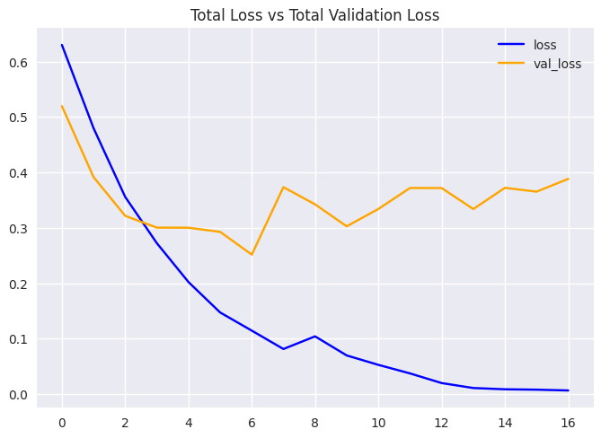
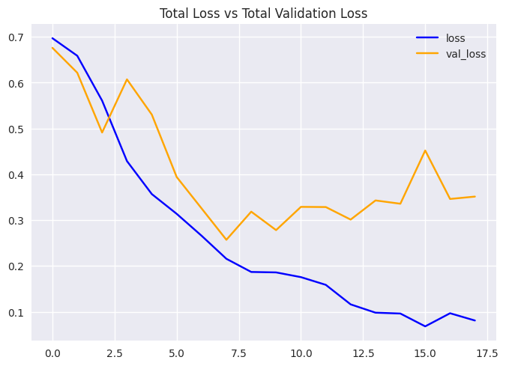
Training and Testing Result(contd)
Optimized Network
Unoptimized Network

Slide 27
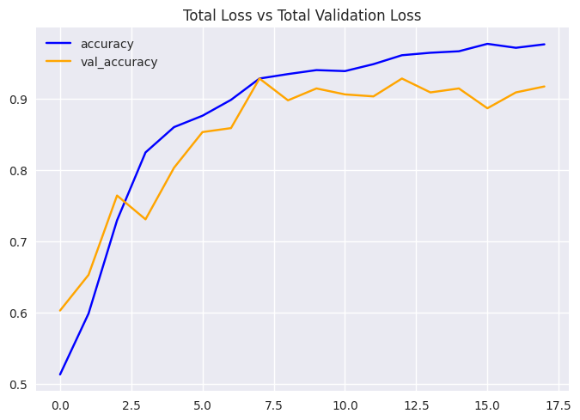
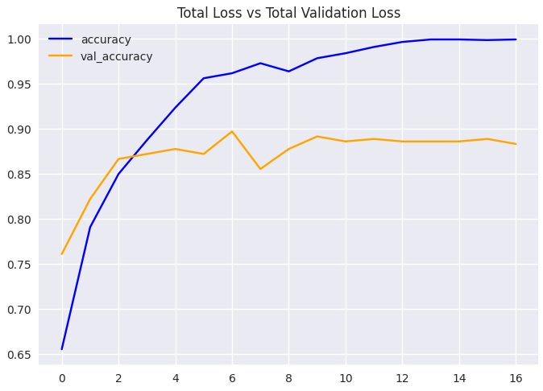
Training and Testing Result(contd)
Optimized Network (accuracy)
Unoptimized Network (accuracy)

Slide 28
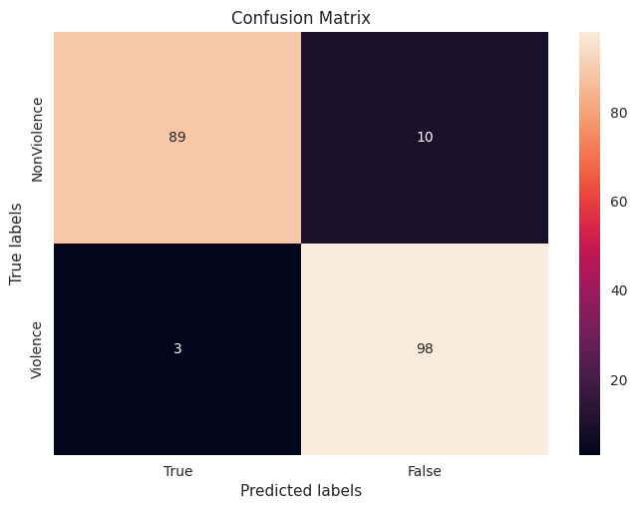
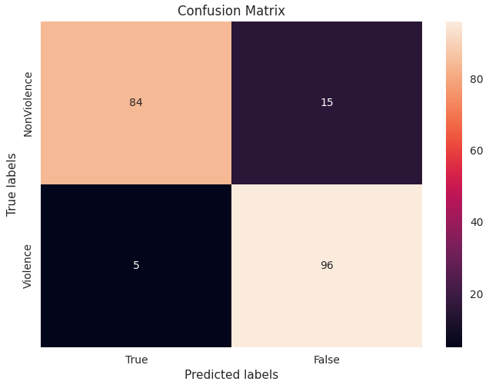
Training and Testing Result(contd)
Optimized Network (CM)
Unoptimized Network (CM)

Slide 29
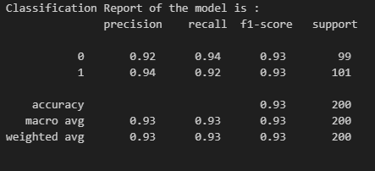
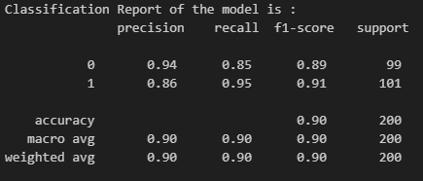
Training and Testing Result(contd)
Optimized Network
Unoptimized Network

Slide 30
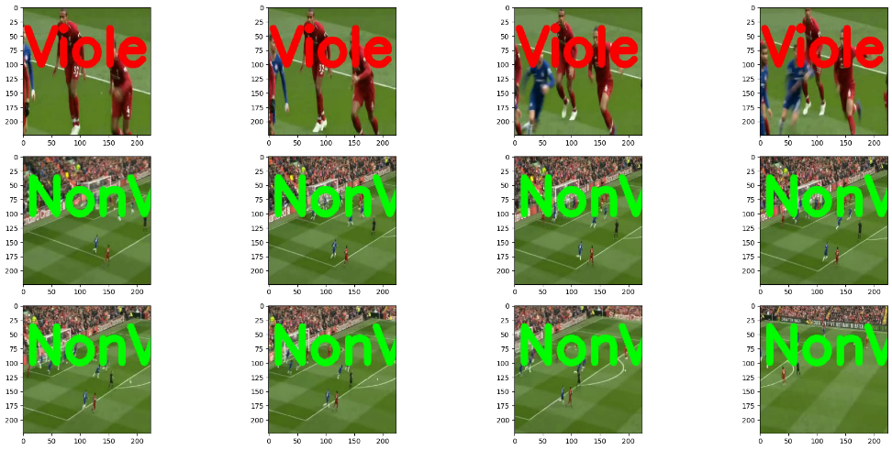
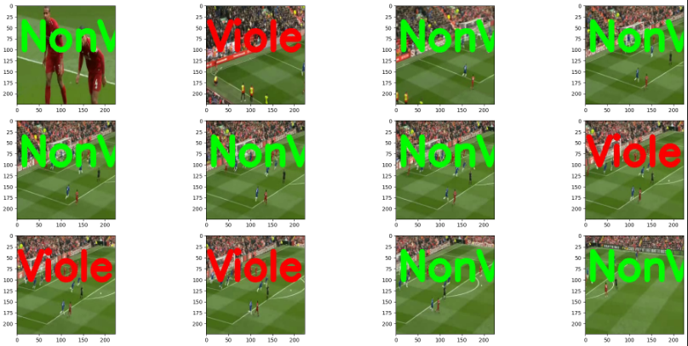
Training and Testing Result(contd)
Optimized Network
Unoptimized Network

Slide 31
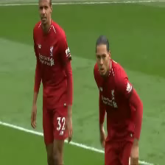
Training and Testing Result(contd)
Inference Video for Optimized Network

Slide 32
GUI Development (input from Video File)
Model Loading: The code loads a pre-trained MobileNetV2 model, which has been optimized for real-time performance.
User Interface: A graphical user interface (GUI) is provided using the Tkinter library. The GUI consists of three buttons:
"Open Video File": Allows users to select a video file for analysis.
"Start Inference": Initiates the violence detection process on the selected video source.
"Quit Inference": Stops the analysis and closes the application.

Slide 33
GUI Development (input from Video File)
Violence Detection: The code captures frames from the selected video source and processes them using the MobileNetV2 model. It displays the processed video stream in a window with real-time violence detection results, including the detected class ("Violence" or "NonViolence"), confidence score, and inference time.
Inference Time Measurement: The code measures the time taken for each inference (frame processing) and displays it alongside the detection results. This allows users to assess the system's performance in real-time.
User Control: Users can quit the inference process at any time by clicking the "Quit Inference" button or pressing the 'q' key.

Slide 34
GUI Development (input from Video File)
Usage:
Users can open a video file of their choice or use a camera feed as the video source. The application will continuously analyze frames for violence, providing real-time feedback.
Purpose:
This code serves as a practical demonstration of violence recognition from video streams and can be a valuable tool for various applications, including security and surveillance.

Slide 35
GUI Development (input from Video Stream)
Camera Selection:
The code allows users to choose between two cameras (e.g., webcams) for video input, providing flexibility in selecting the video source.
Video File Input:
Users can also load a video file for inference, making it suitable for analyzing pre-recorded videos.
Deep Learning Model:
The code loads a pre-trained deep learning model, specifically "optimized_mobilenet_lstm_model.h5," using TensorFlow and Keras. This model is responsible for violence detection.

Slide 36
GUI Development (input from Video Stream)
Real-time Inference:
The core functionality involves real-time inference on video frames from the selected camera or video file.
Each frame is preprocessed and fed into the loaded model for violence detection.
The code measures the inference time for each frame, which can be valuable for performance analysis.
Detection Results:
Detected results are displayed on the screen in real-time. Frames are annotated with:
Detected class label (Violence or NonViolence).
Confidence score for the detected class.
Timestamp of the detection event.
Inference time for the frame.

Slide 37
GUI Development (input from Video Stream)
Camera Switching:
Users can seamlessly switch between two connected cameras during runtime using the "Switch Camera" button.
Recording Timestamps:
In the case of violence detection, the code records the timestamp of each detection event in a "violence_timestamps.txt" file for future reference or analysis.
User Interaction:
The graphical user interface (GUI) is built using Tkinter, providing intuitive buttons for camera switching, starting and stopping inference.

Slide 38
Conclusion
Dataset Creation: The presentation began by addressing the scarcity of relevant datasets and the need to create a comprehensive dataset encompassing both violent and non-violent scenarios. The dataset consists of 1000 violence and 1000 non-violence videos, capturing real-life street fight situations and various non-violent human actions.
Deep Learning Model: A pivotal component of this solution is the utilization of the MobileNetV2 model, which has been favored over the YOLO algorithm due to its capacity for real-time processing and efficient hardware utilization. The MobileNetV2 model is pre-trained and fine-tuned to perform violence detection.

Slide 39
Conclusion
Real-time Detection: The code showcased in this presentation provides real-time inference capabilities, enabling immediate violence recognition from live camera streams or video files. The deep learning model processes each frame efficiently and annotates it with class labels, confidence scores, timestamps, and inference times.
User Interaction: The user-friendly graphical user interface (GUI) facilitates easy interaction with the system. Users can switch between multiple cameras, start and stop inference, and record timestamps of violence events for further analysis.

Slide 40
Conclusion
Performance Metrics: To assess the model's effectiveness, it is essential to measure the Frames Per Second (FPS). Higher FPS values indicate improved real-time performance, making the system more reliable for timely violence detection.
Applications: The versatility of this solution makes it suitable for a wide range of applications, including security and surveillance systems, crowd management, public safety, and more. Its ability to process real-time video streams makes it a valuable tool in preventing and addressing violent incidents.
Future Directions: While this presentation has demonstrated a robust solution, future directions include continuous model refinement, scalability for multiple cameras, and integration with broader security systems.

Slide 41
Thank You!

